Slide 1

Data Structure Application:
Presented by:
Shiva Srivastava
Guided by:
Sir Himanshu Sharma

Slide 2
Design Browser History:
You have a browser of one tab where you start on the homepage and you can visit another URL, on moving on new URL forward Browser history is deleted and new doubly linked list of browser history form with backward browser history.
BrowserHistory(string homepage) Initalizes the object with the homepage of the browser.
If you visit site from current page. It clears up all the forward history.

Slide 3





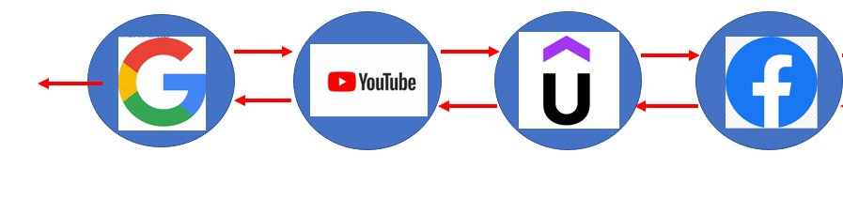

Visiting sites
NULL
NULL
After visiting mysirg.com from Facebook
NULL
NULL
New list of browsing history form

Slide 4
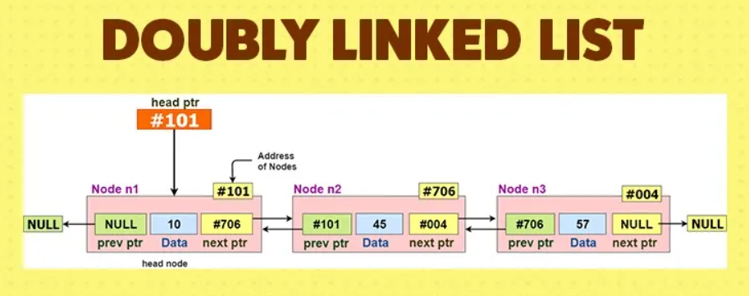

Slide 5
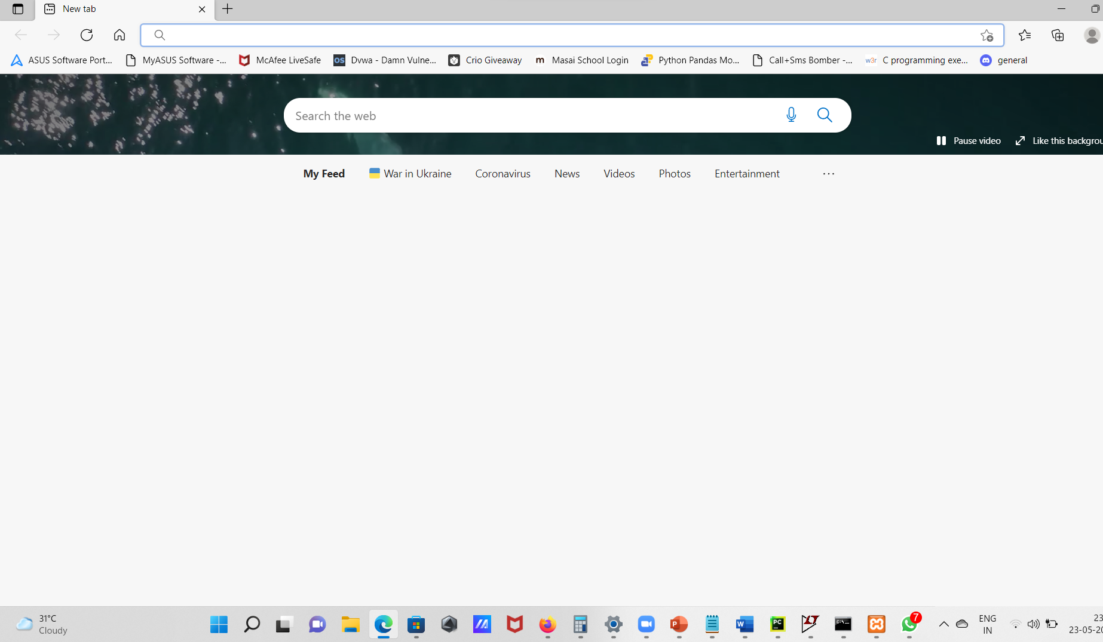
Google Homepage

Slide 6
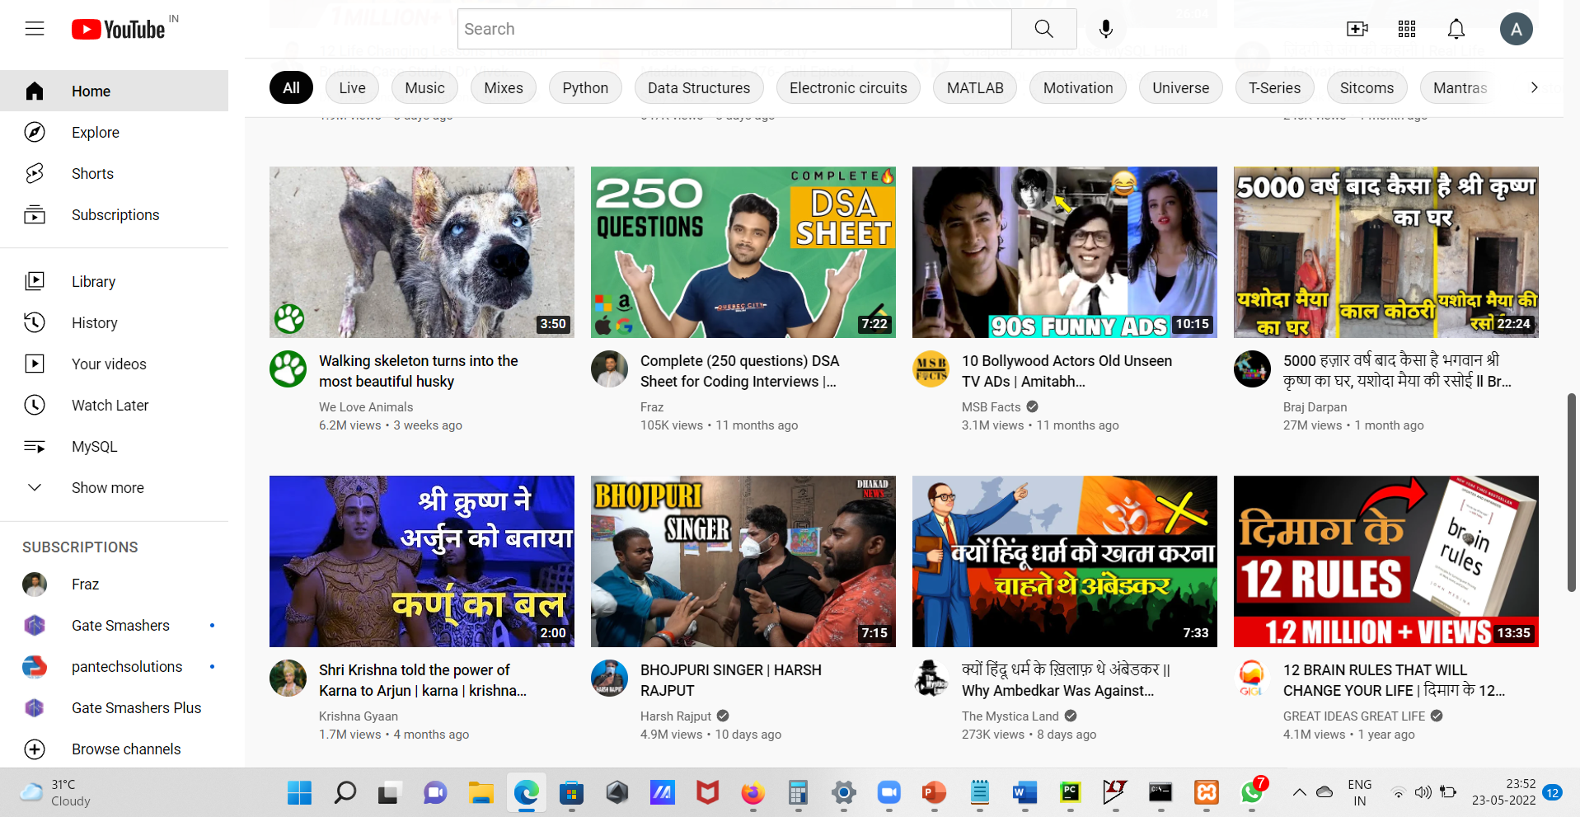
YouTube page after homepage

Slide 7
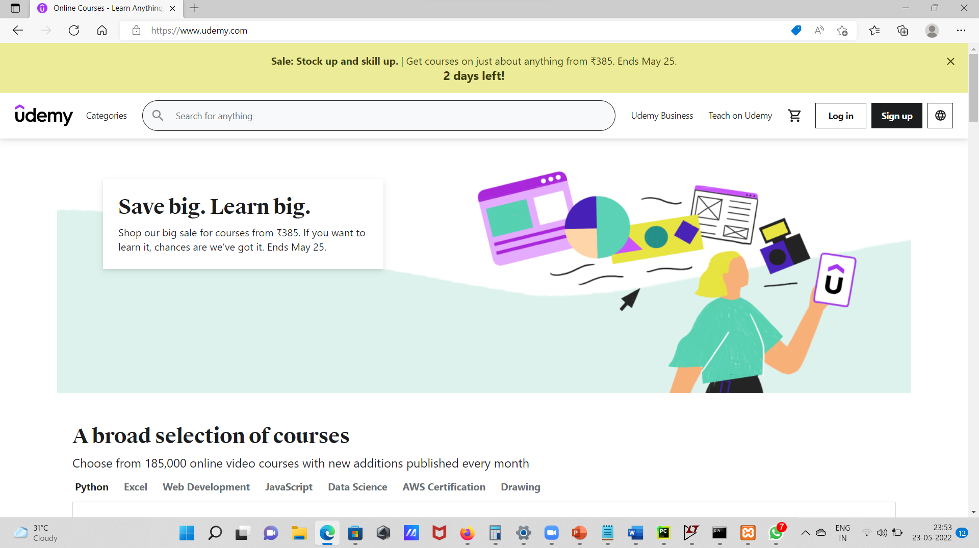
Udemy after YouTube

Slide 8
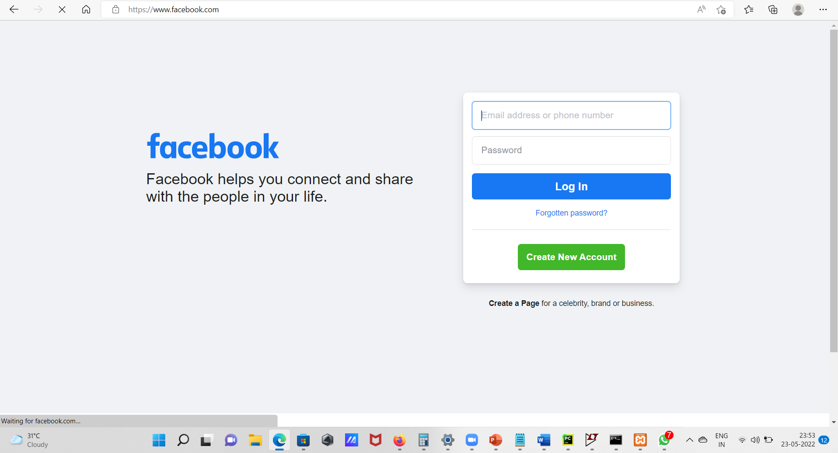
Facebook after Udemy

Slide 9
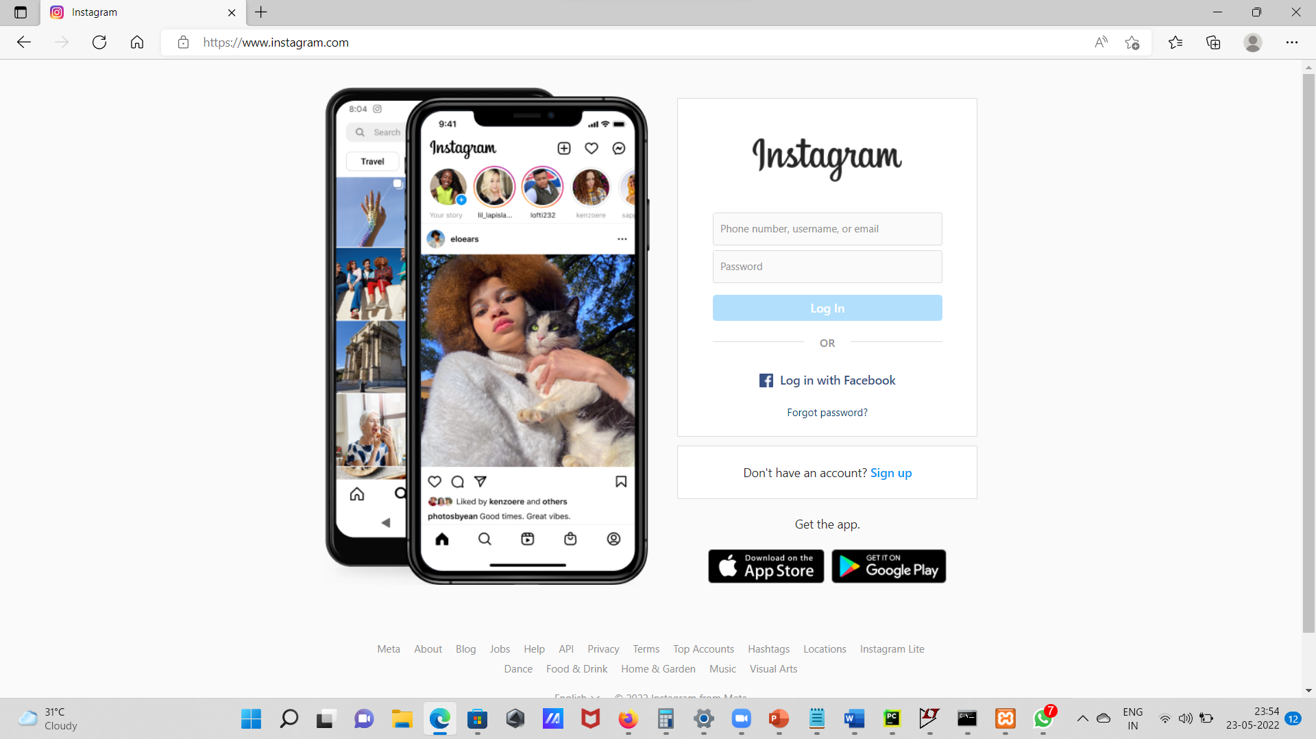
Instagram after Facebook

Slide 10
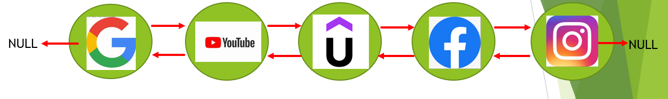
Doubly linked list of Browser history formed

Slide 11
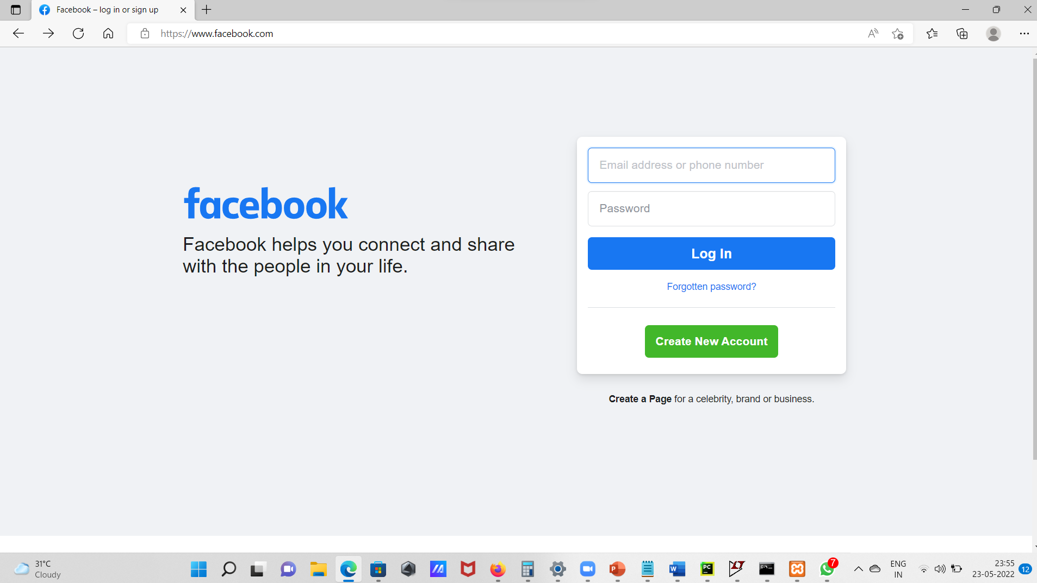
Move backward to Facebook from Instagram

Slide 12
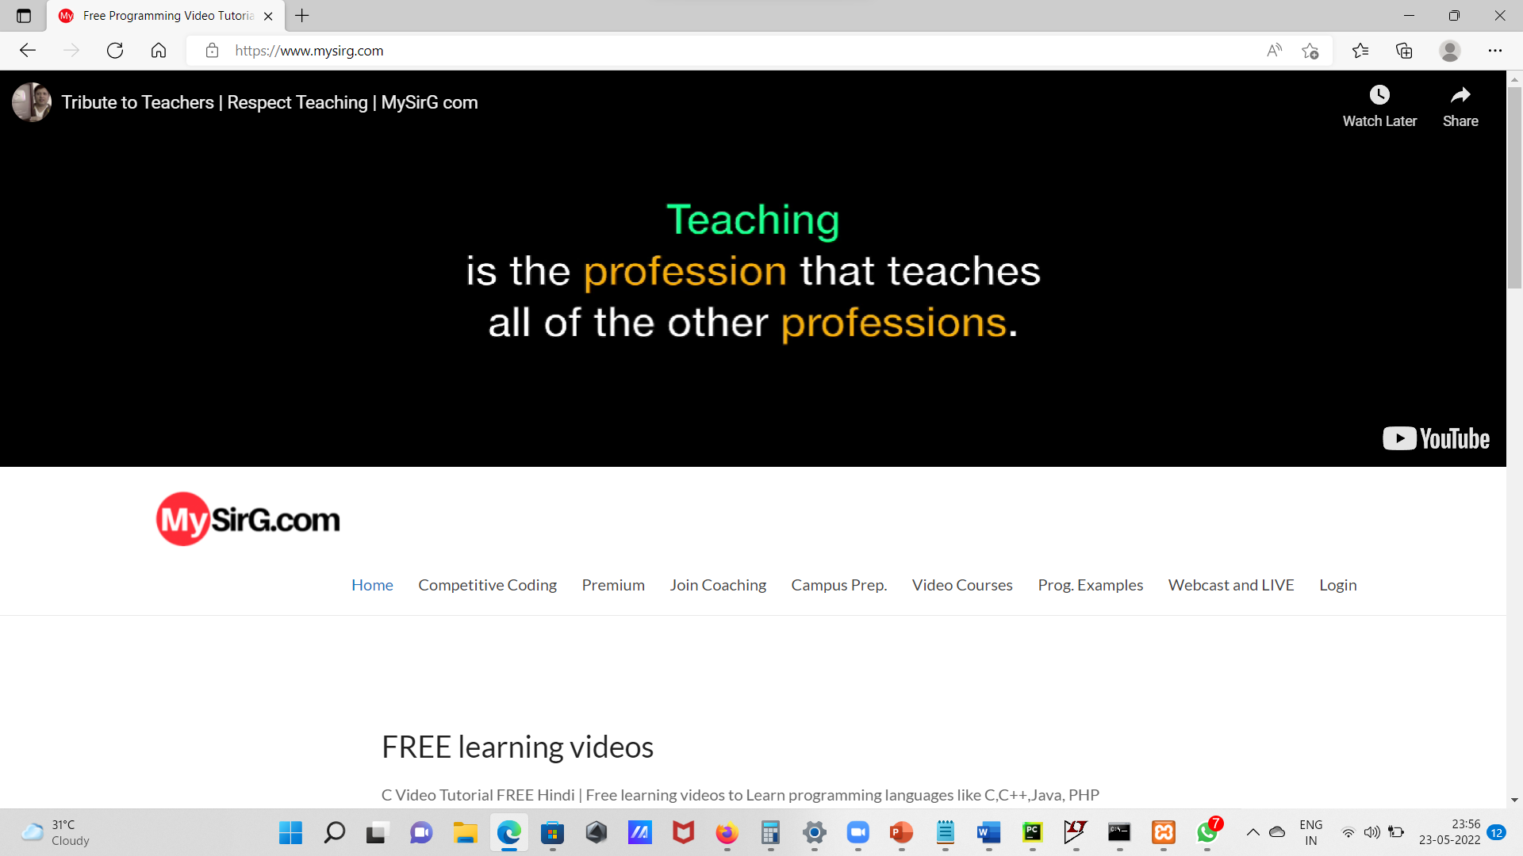
Search Mysirg.com from Facebook page

Slide 13
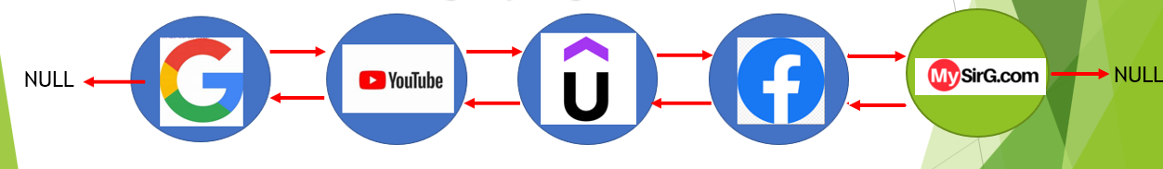
After Searching Mysirg.com
Forward search history Automatically deleted
And new doubly linked list formed
By this way Browser history of single tab work.

Slide 14
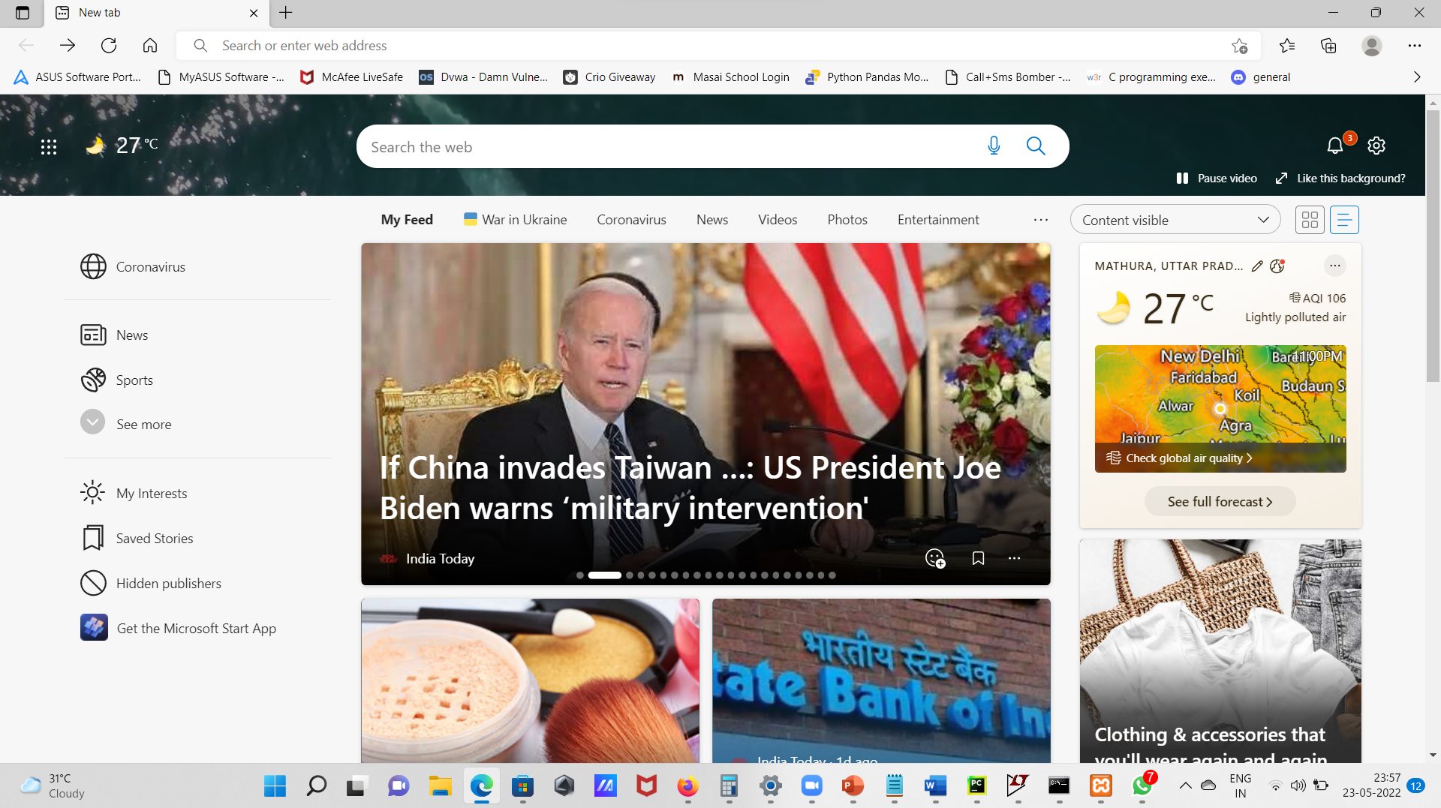
Move to First page of homepage

Slide 15
Proper Code
#include<stdio.h>
#include<stdlib.h>
#include<string.h>
struct BrowserHistory{
char url[20000];
struct BrowserHistory* forward;
struct BrowserHistory* backward;
}*home;
// typedef struct BrowserHistory BrowserHistroy;
struct BrowserHistory * Browser_history_homepage(char *homepage)
{
home= (struct BrowserHistory*)malloc(sizeof(struct BrowserHistory));
strcpy(home->url,homepage);
home->backward=NULL;
home->forward=NULL;
return home;
}

Slide 16
struct BrowserHistory * visit_site(struct BrowserHistory* curr , char *url)
{ if(curr!=NULL)
{
struct BrowserHistory* ptr_delete, *ptr=curr;
while(ptr!=NULL)
{
// ptr=ptr_delete->forward;
// free(ptr_delete);
// ptr_delete=ptr;
if(ptr->forward!=NULL)
{ptr_delete=ptr->forward;
ptr=ptr_delete;
ptr=ptr->forward;
free(ptr_delete);}
else
ptr=ptr->forward;
}
}

Slide 17
struct BrowserHistory * back_site(struct BrowserHistory* curr , int backward_step)
{ int steps=0,i;
struct BrowserHistory *ptr=home;
while(ptr!=NULL)
{steps++;
ptr=ptr->backward;
}
if(backward_step<steps)
{ for (i=steps;i>steps-backward_step;i--)
{
curr=curr->backward;
}
return curr;}
else if( backward_step==steps)
{
while(curr->backward!=NULL)
{
curr=curr->backward;
}
return curr;
}
}

Slide 18
int main()
{int x=1;
char url[20000];
int backward_step;
struct BrowserHistory* curr;
// struct BrowserHistory* curr, *ptr=home;
// printf("%s",ptr->url);
curr=Browser_history_homepage("google.com");
struct BrowserHistory *ptr=home;
while(x)
{printf("Enter your choice \n '1' for visit_new site \n'2' for visiting backward sites '3' for printing whole current history site \n");
scanf("%d%*c",&x);
switch (x)
{
case 1:
fflush(stdin);
scanf("%[^\n]s",url);
curr=visit_site(curr,url);
break;

Slide 19
case 2:
scanf("%d",&backward_step);
curr=back_site(curr,backward_step);
break;
case 3:
fflush(stdin);
// printf("%u\n",ptr);
while(ptr!=NULL)
{printf("%s\n",ptr->url);
ptr=ptr->forward;
}
ptr=home;
}
}
}

Slide 20
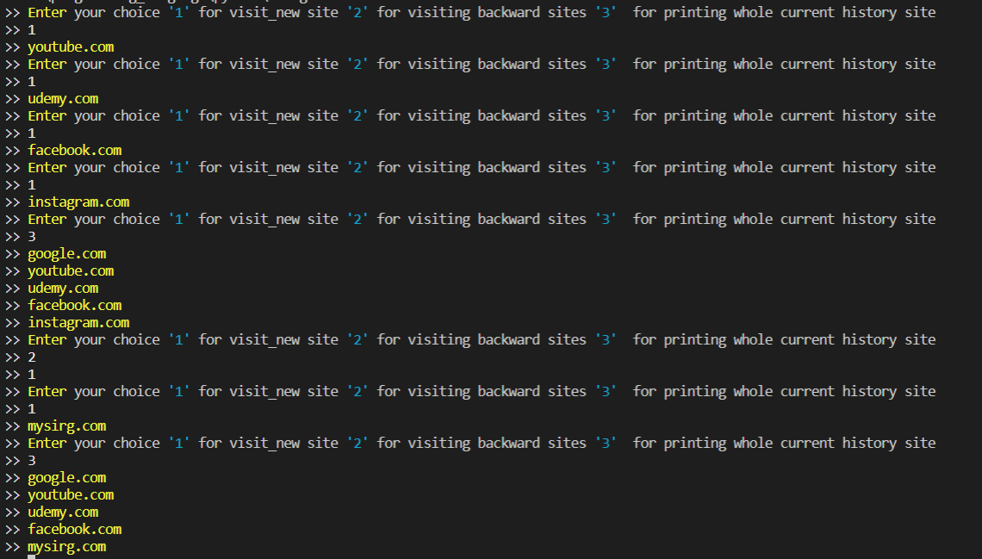
Output:

Slide 21
Thank You

